Slide 1


Doctor- Patient Appointment System
Developed By,
Vivek Kumar Verma
( CSM21040 )
Under the guidance of,
Mr. Nimish Bhardwaj
Programmer Analyst,
TechVariable
Dr. Rosy Sarmah
Associate Professor,
Tezpur University
Date: 09/06/2023

Slide 2
Problem
Statements
Inefficient and time-consuming appointment booking process in the healthcare industry.
Lack of a centralized system for managing appointments and medical records.
Difficulty in finding suitable doctors based on specialization, location, and availability.
Limited communication and coordination between patients and doctors.
Manual handling of paperwork and medical reports.

Slide 3

Solution Overview
A platform for seamless appointment booking, efficient management of appointments and medical records
Streamlined processes, enhanced accessibility healthcare by digital transformation

Slide 4
Requirements
Login &
registration
Profile
picture Upload
Role based View
Doctor
Account
activation
Role based authentication
Medical record Upload
Search doctor
Book appointment
Multiple visiting location
Alert system
Email notification
Educational details of doctor
Easy to use interface
Short summary of today’s appointments
Admin Panel

Slide 5







Stack Technology

Slide 6

General-Purpose Language
Simple and Readable Syntax
Rich Standard Library
Strong Community and Ecosystem
High-level Python web framework
Rapid development capabilities
Rich set of built-in features
Model-View-Template (MVT) architectural pattern

Slide 7


Open-source
Seamless scalability
Supports complex queries
Relational database management system
Speed and efficient development
Responsive interface
Enhance User Satisfaction
Pre-defined utility classes

Slide 8
Popular templating engine for Python
Offers template inheritance and variable substitution
Enables us to create flexible and customizable views
Renders dynamic contents and generates HTML templates
Enables communication over email
SMTP is an application-layer protocol
Standard protocol for sending and receiving emails over the internet
We use it for sending notification message

Slide 9
Why Django ?
Django, a high-level Python web framework, provides a solid foundation for developing scalable and secure applications.
Its Model-View-Template (MVT) architecture simplifies development, separates concerns, and promotes code reusability.
Django's extensive ecosystem, built-in features, and active community support make it an ideal choice for our project.
Comes with pre-build admin panel, easy to maintained file structure etc.

Slide 10
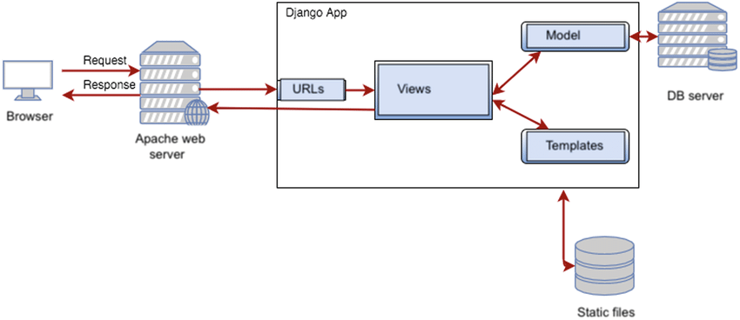
System Architecture
Model View Template (MVT)

Slide 11
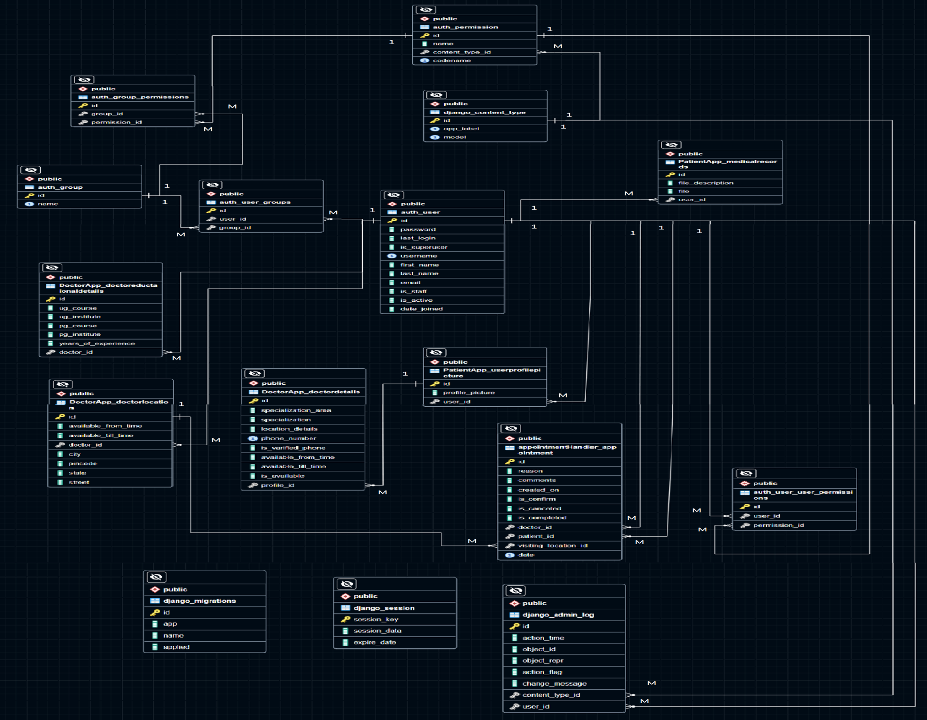
ER Diagram Of System Database

Slide 12
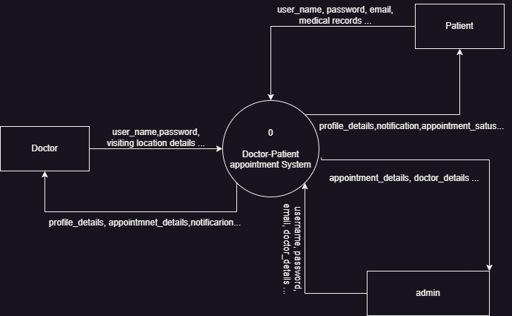
Data Flow Diagrams
Level 0 DFD / Context Diagram

Slide 13
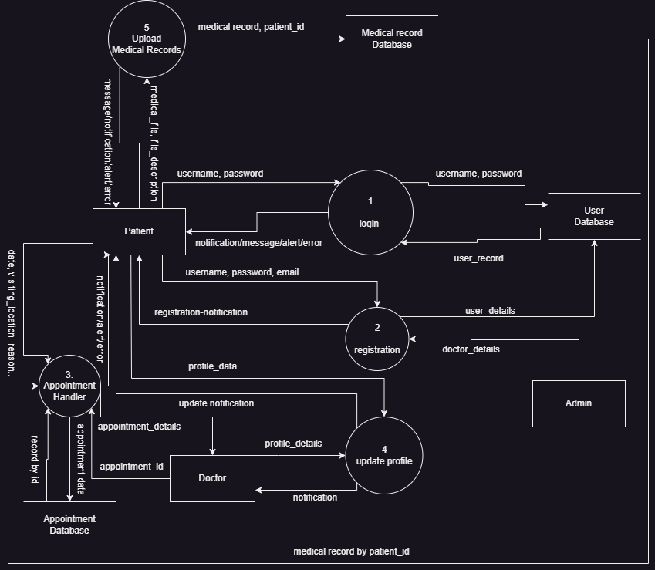
Data Flow Diagrams
Level 1

Slide 14
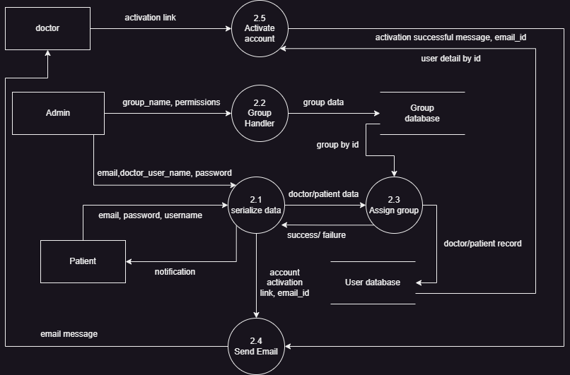
Data Flow Diagrams
Level 2 for Registration

Slide 15
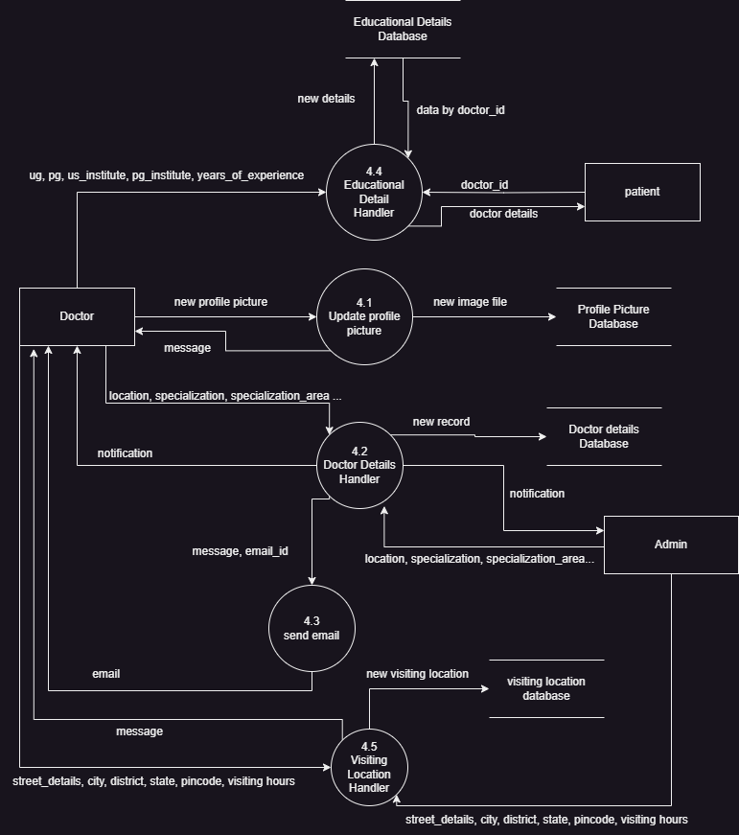
Data Flow Diagrams
Level 2 for Profile Handler

Slide 16
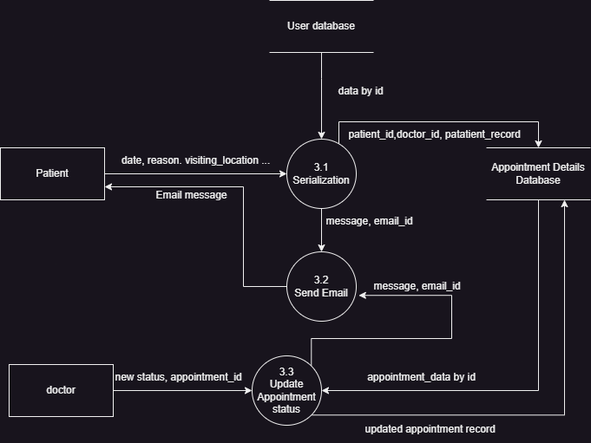
Data Flow Diagrams
Level 2 for Appointment Handler

Slide 17

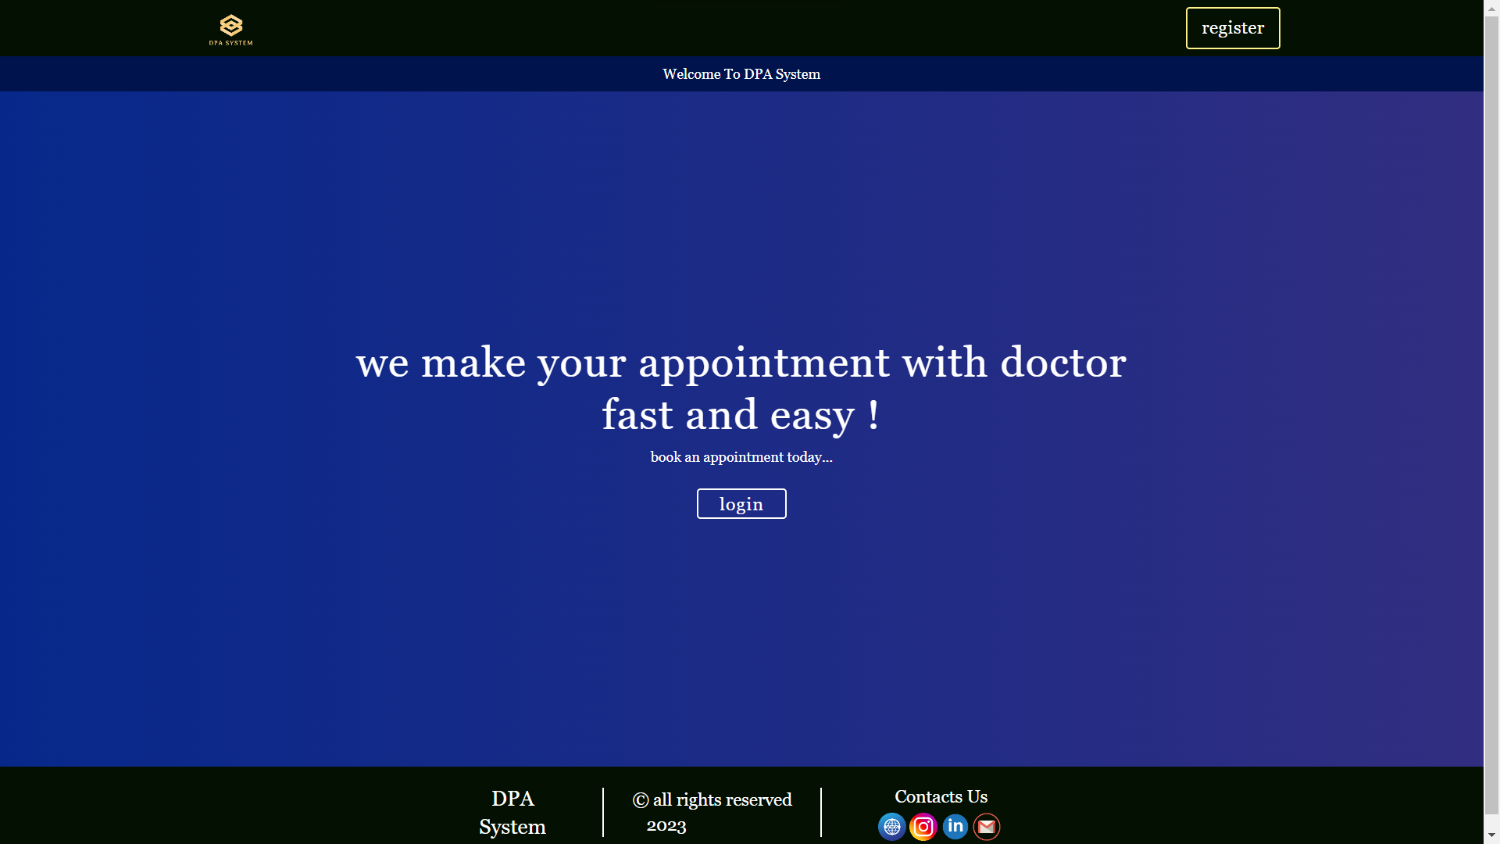
Screenshots

Slide 18
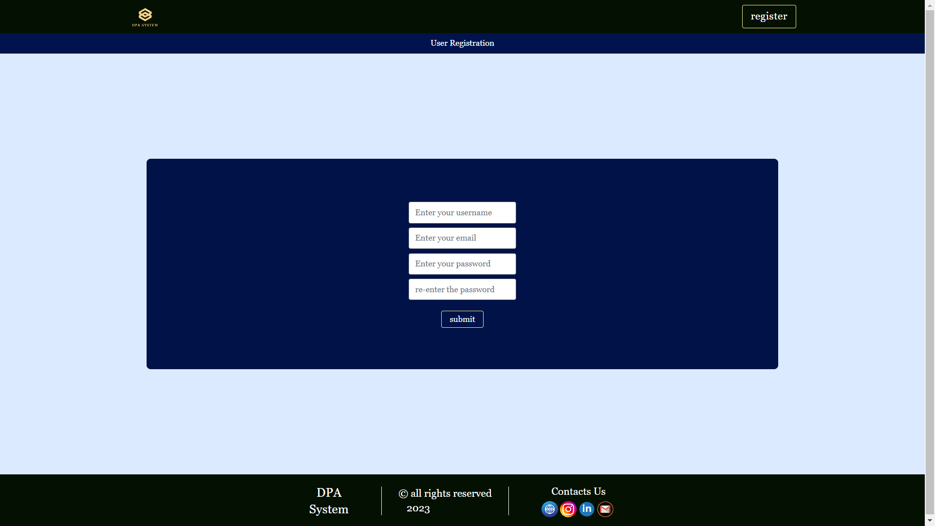
Screenshots

Slide 19
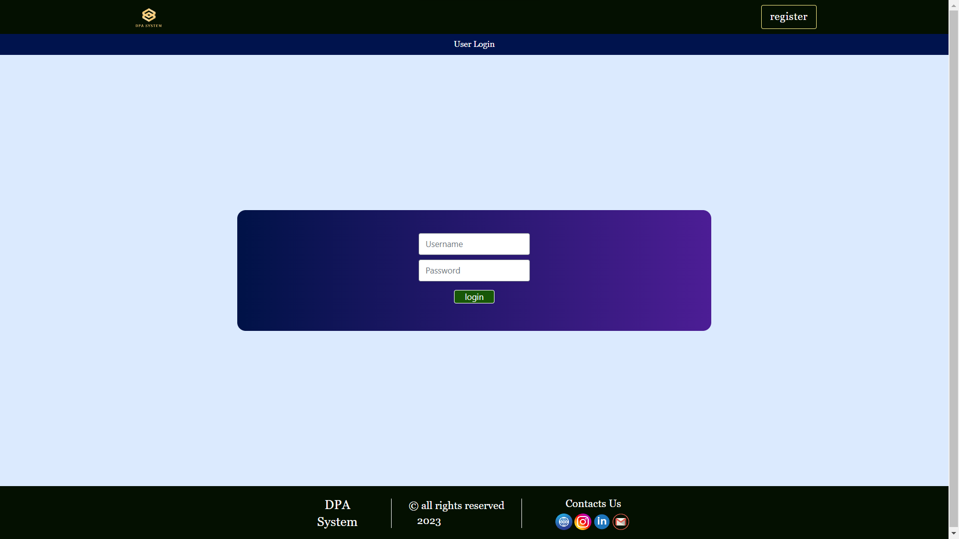
Screenshots

Slide 20
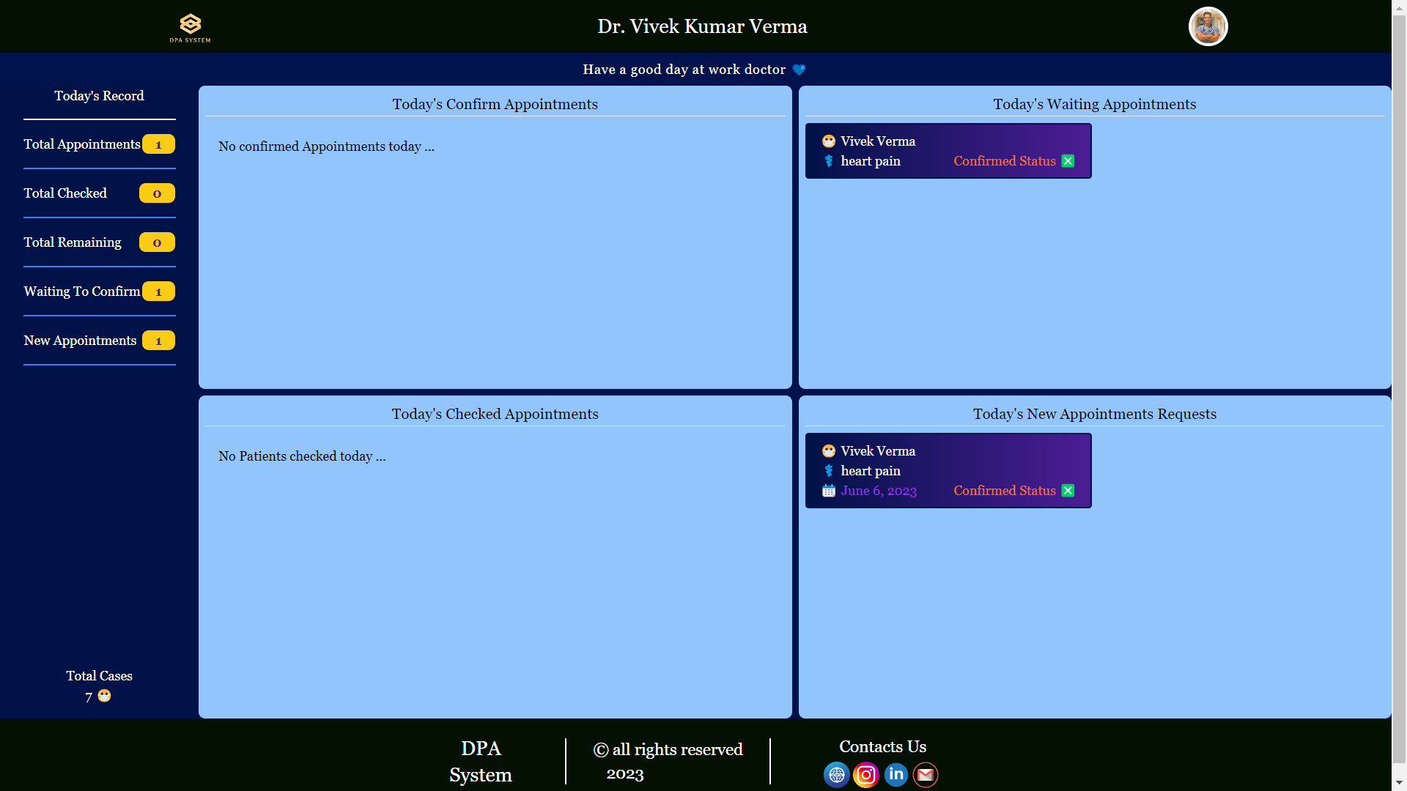
Screenshots

Slide 21
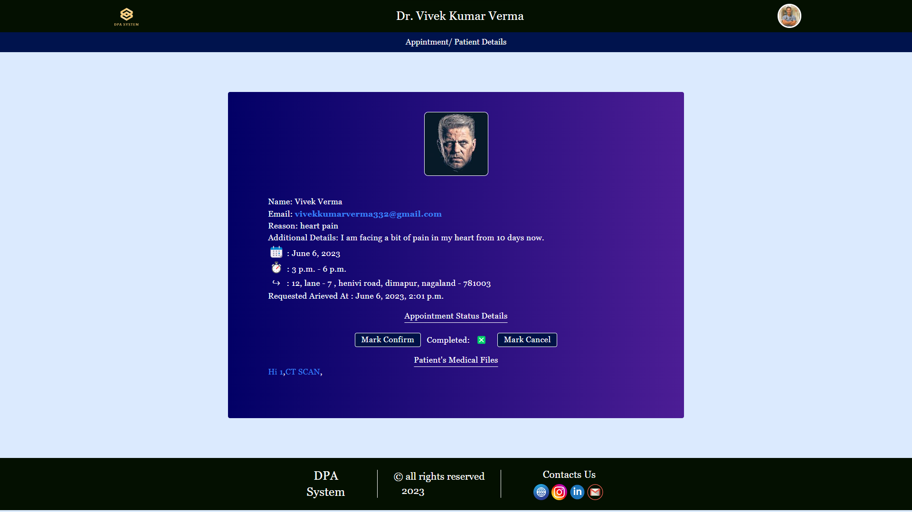
Screenshots

Slide 22
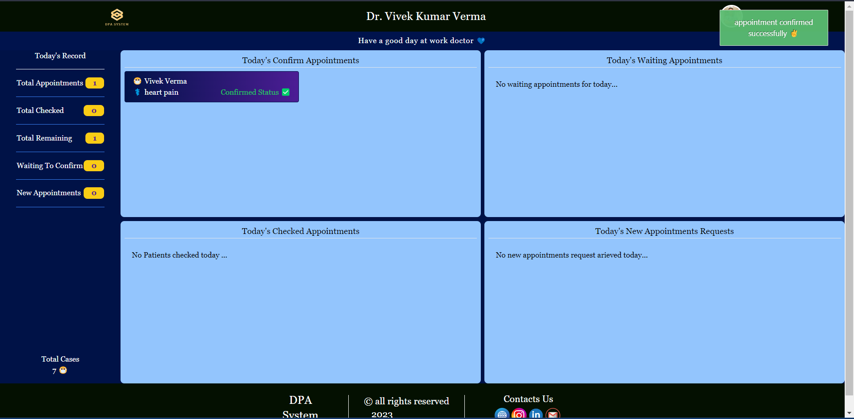
Screenshots

Slide 23
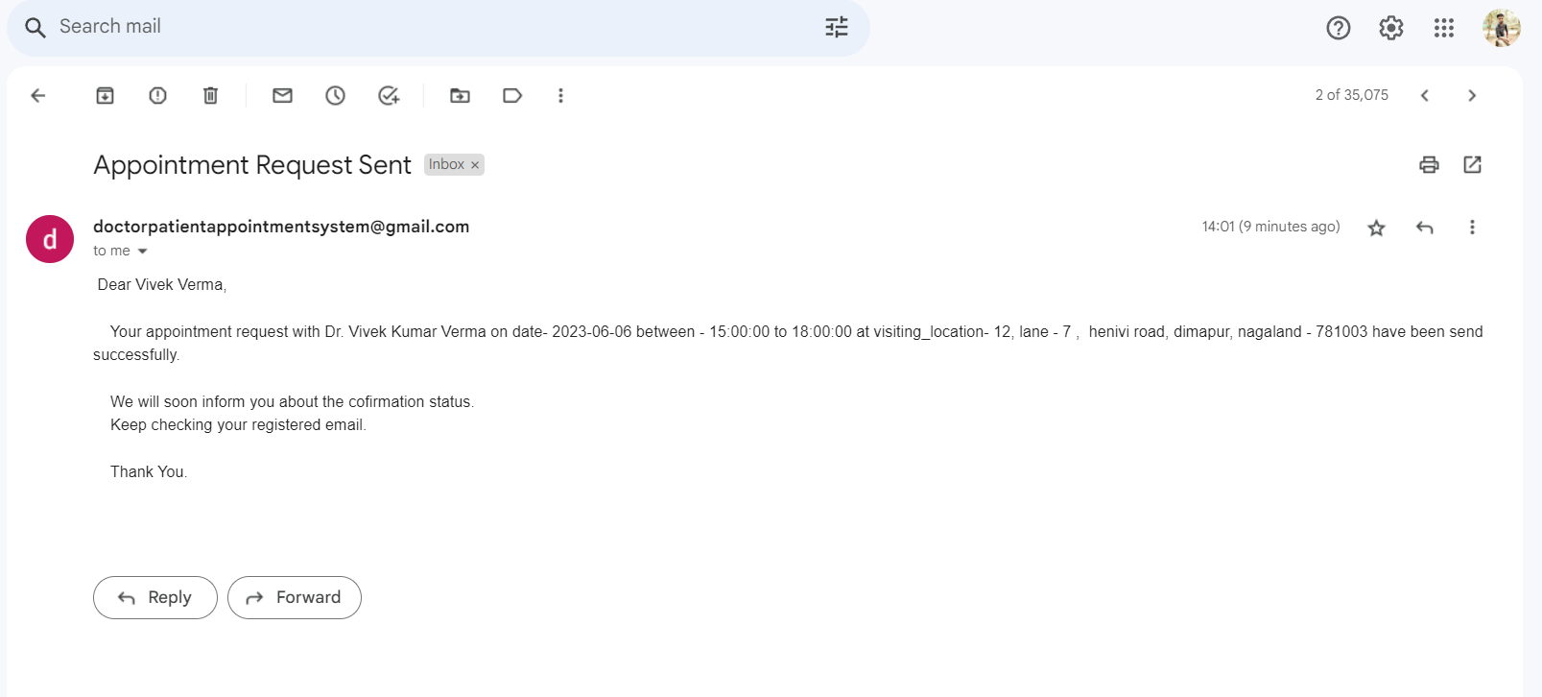
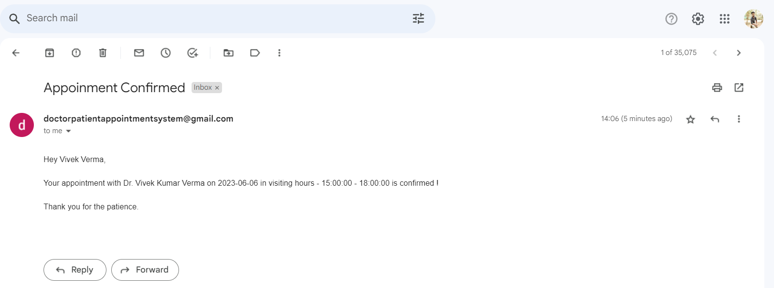
Screenshots

Slide 24
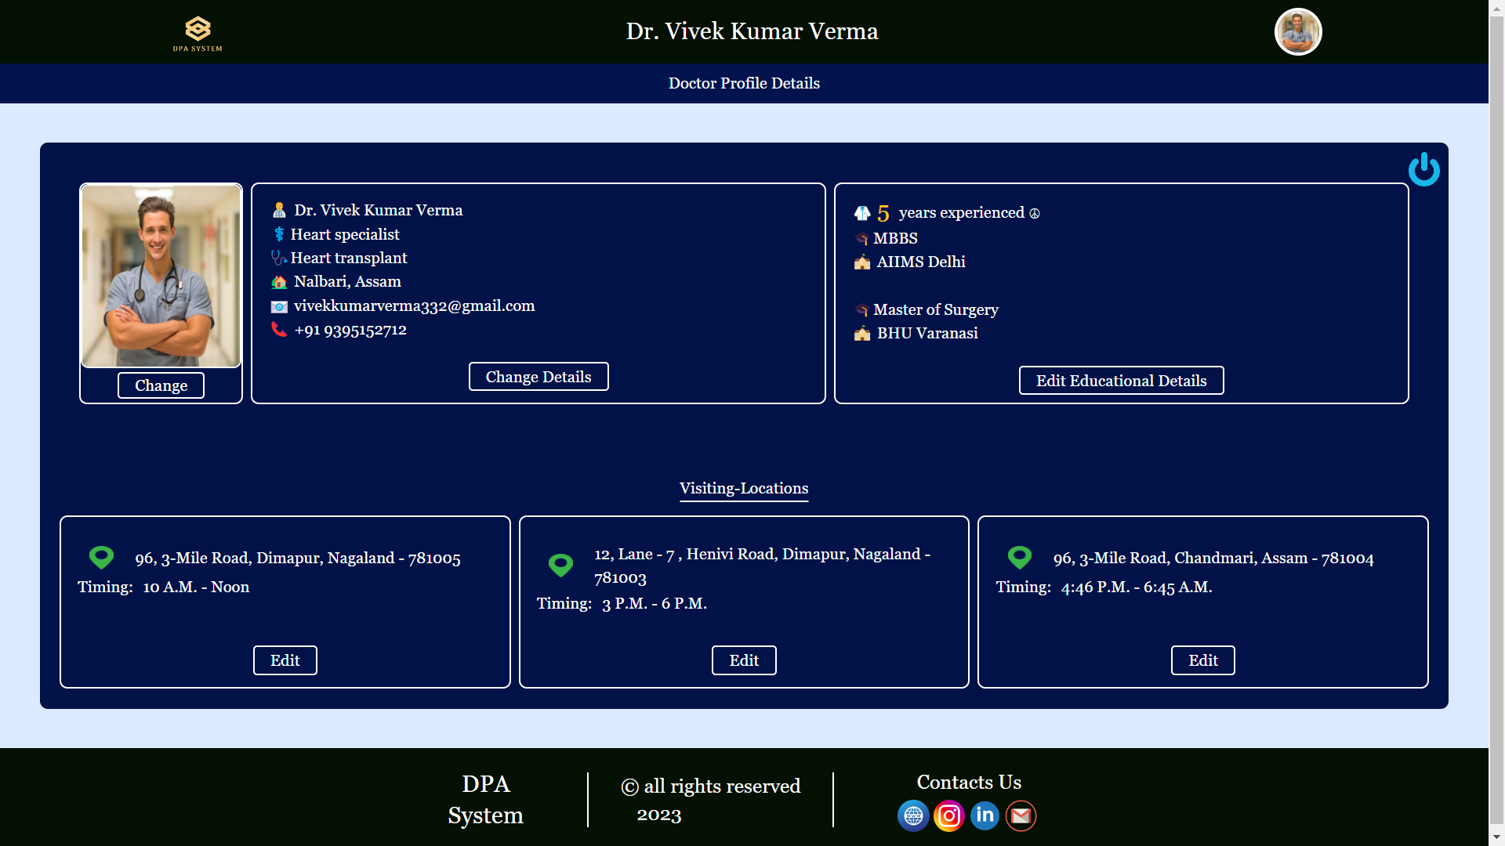
Screenshots

Slide 25
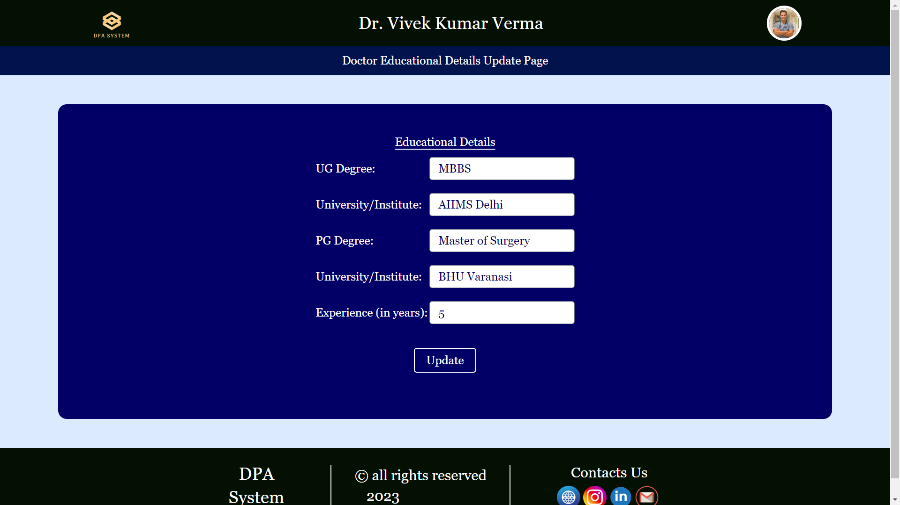
Screenshots

Slide 26
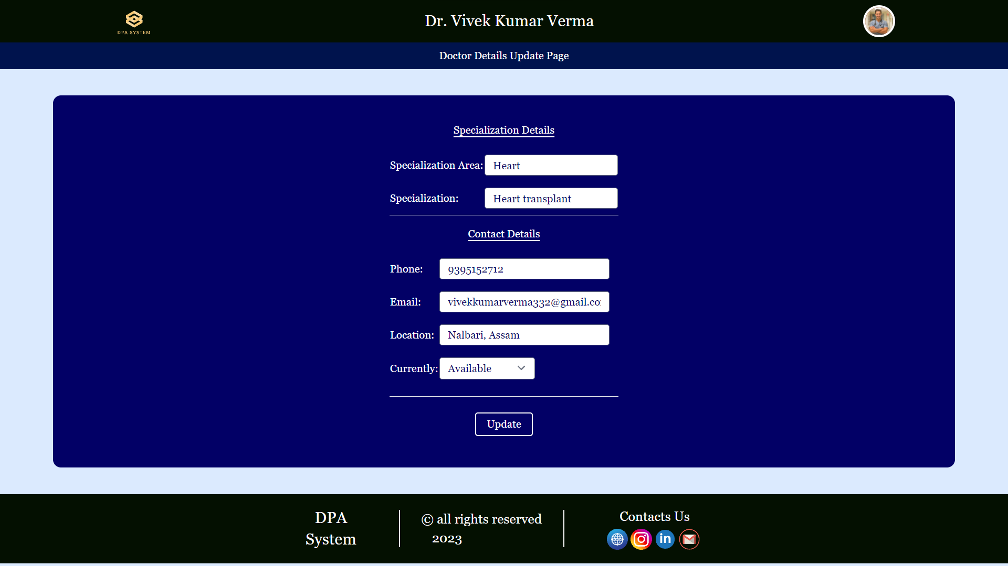
Screenshots

Slide 27
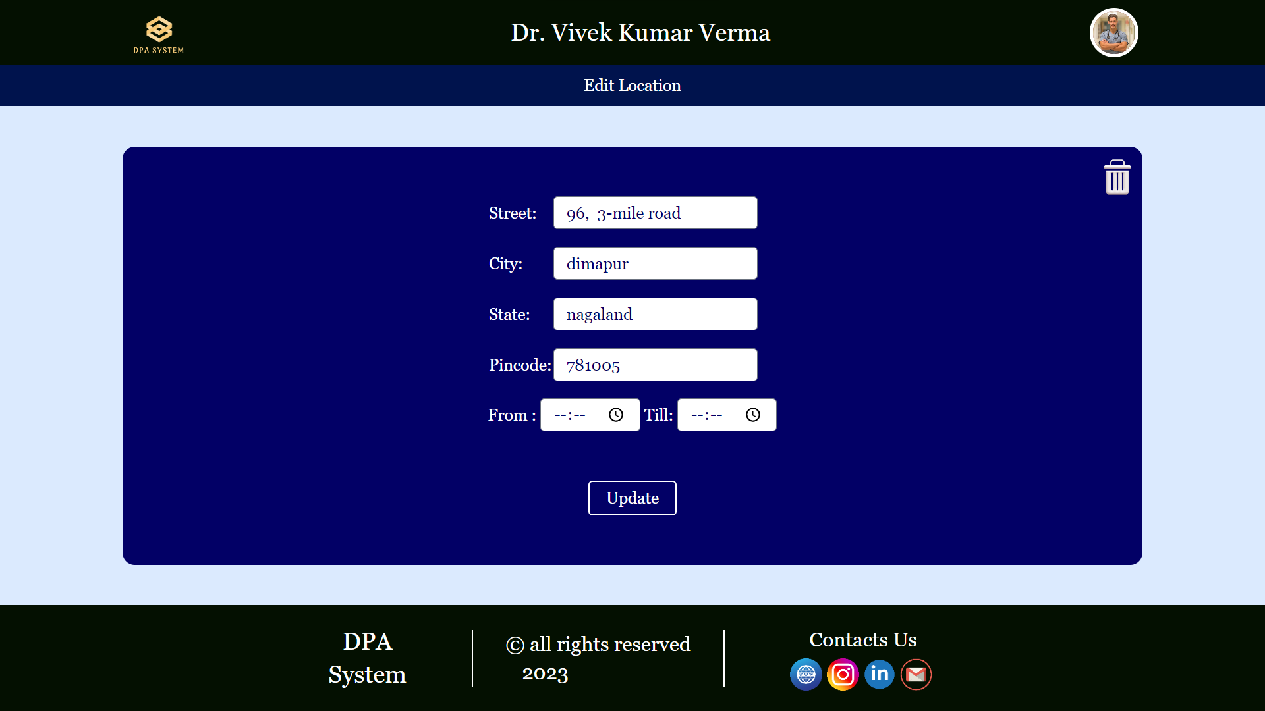
Screenshots

Slide 28
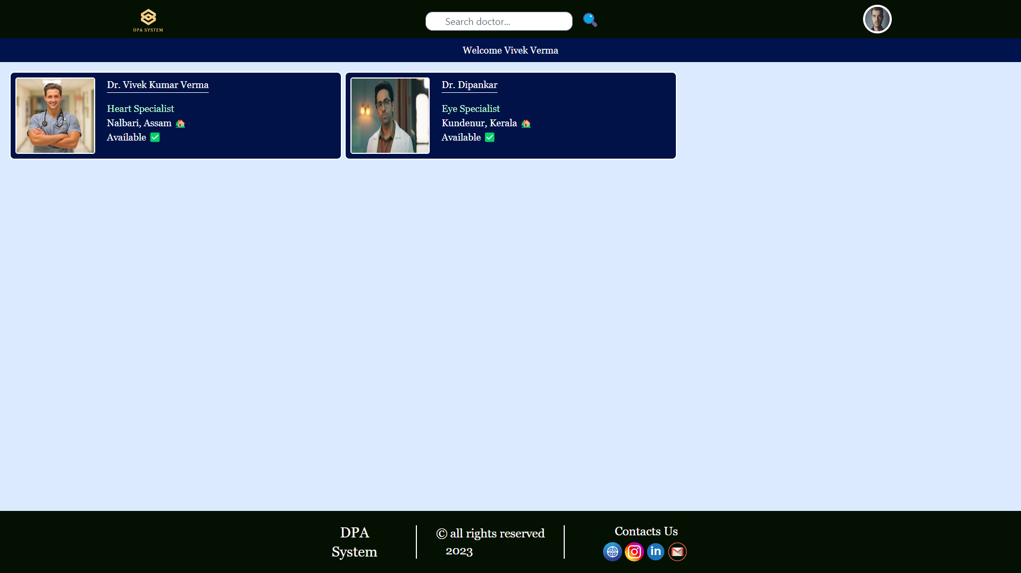
Screenshots

Slide 29
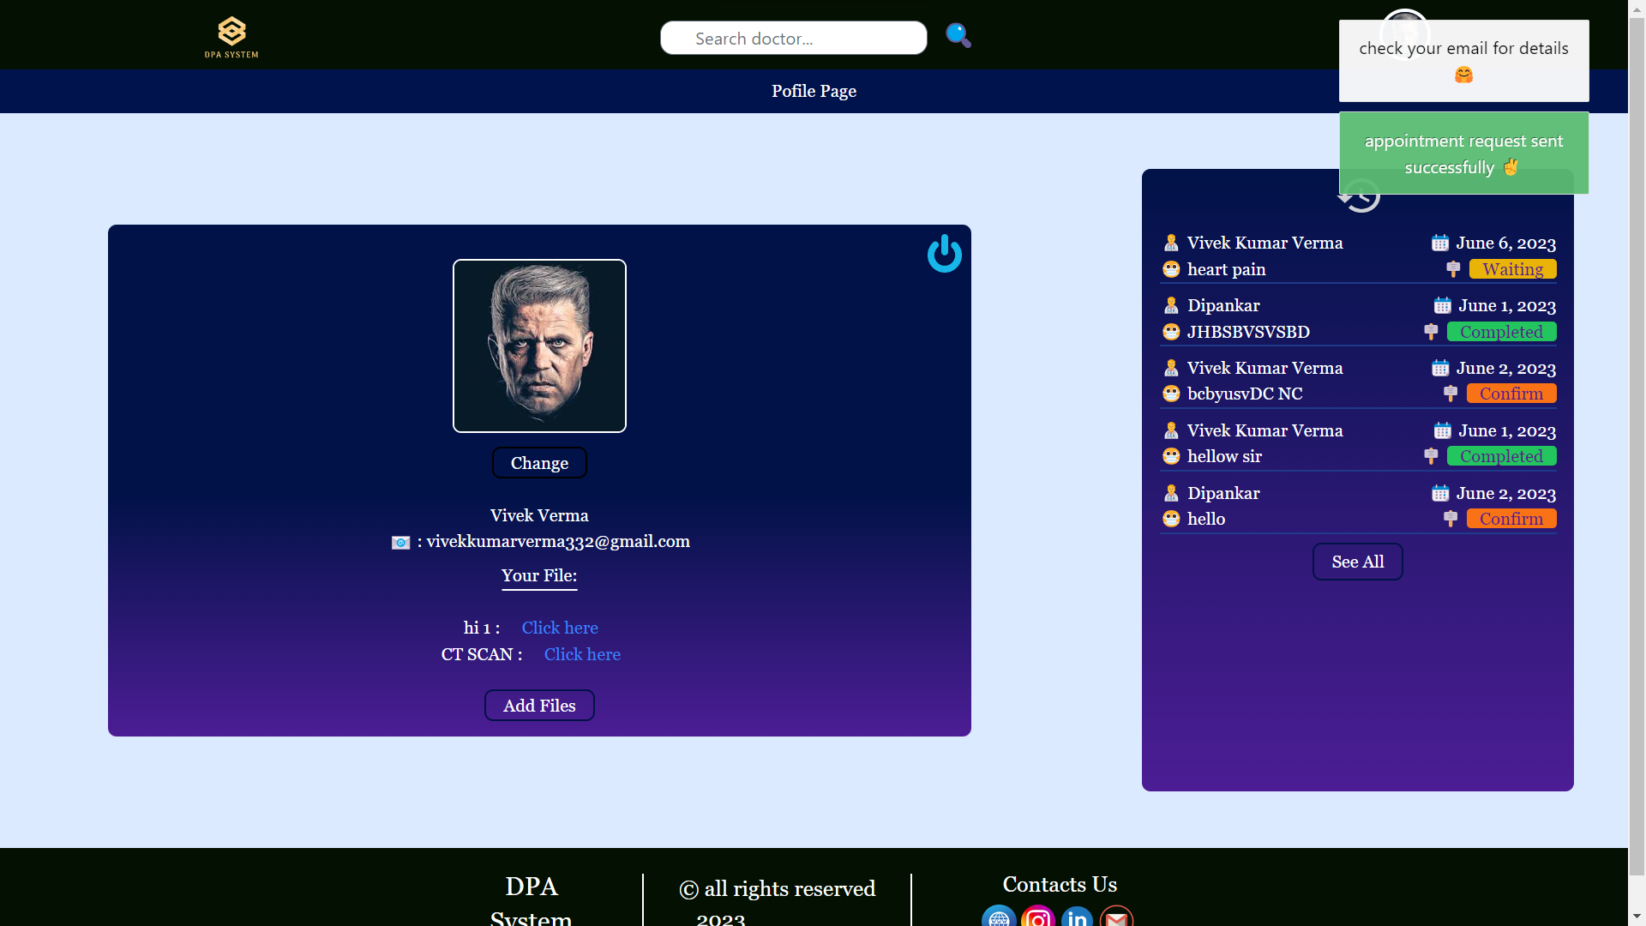
Screenshots

Slide 30
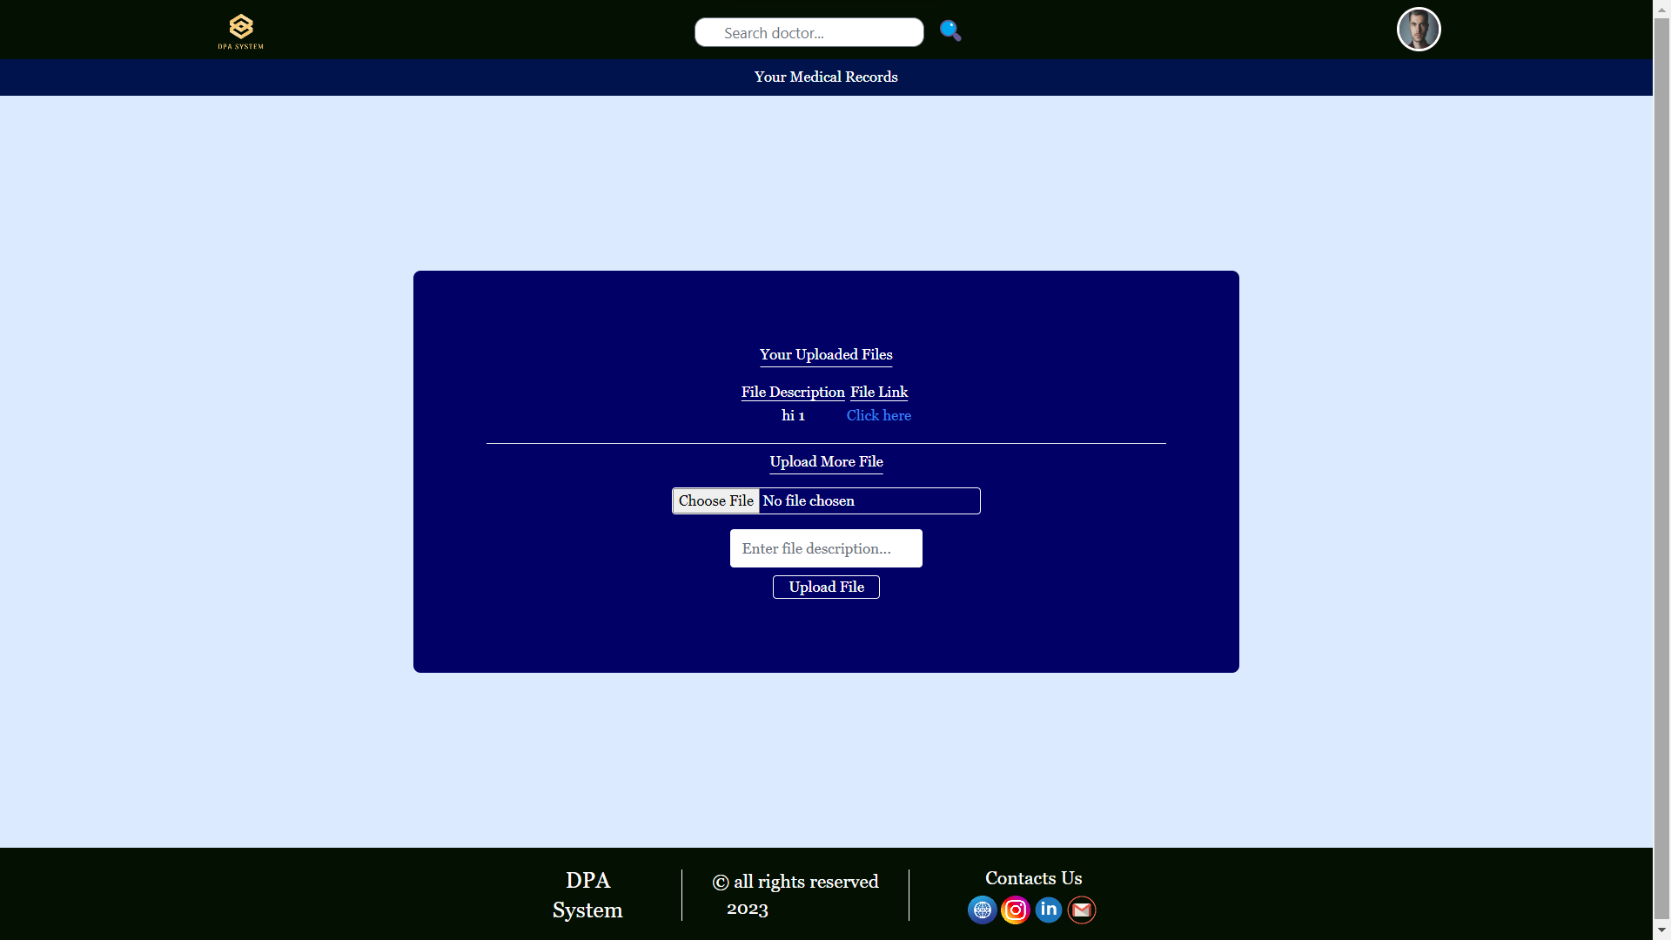
Screenshots

Slide 31
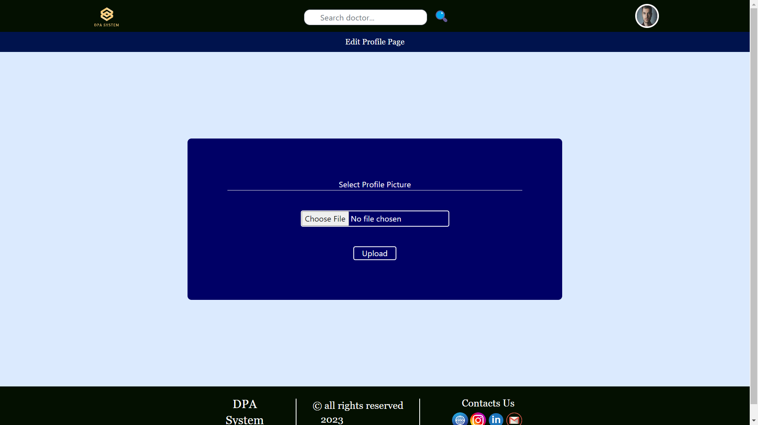
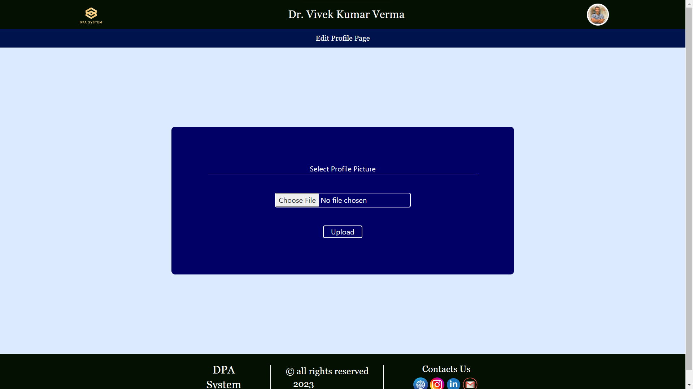
Screenshots

Slide 32
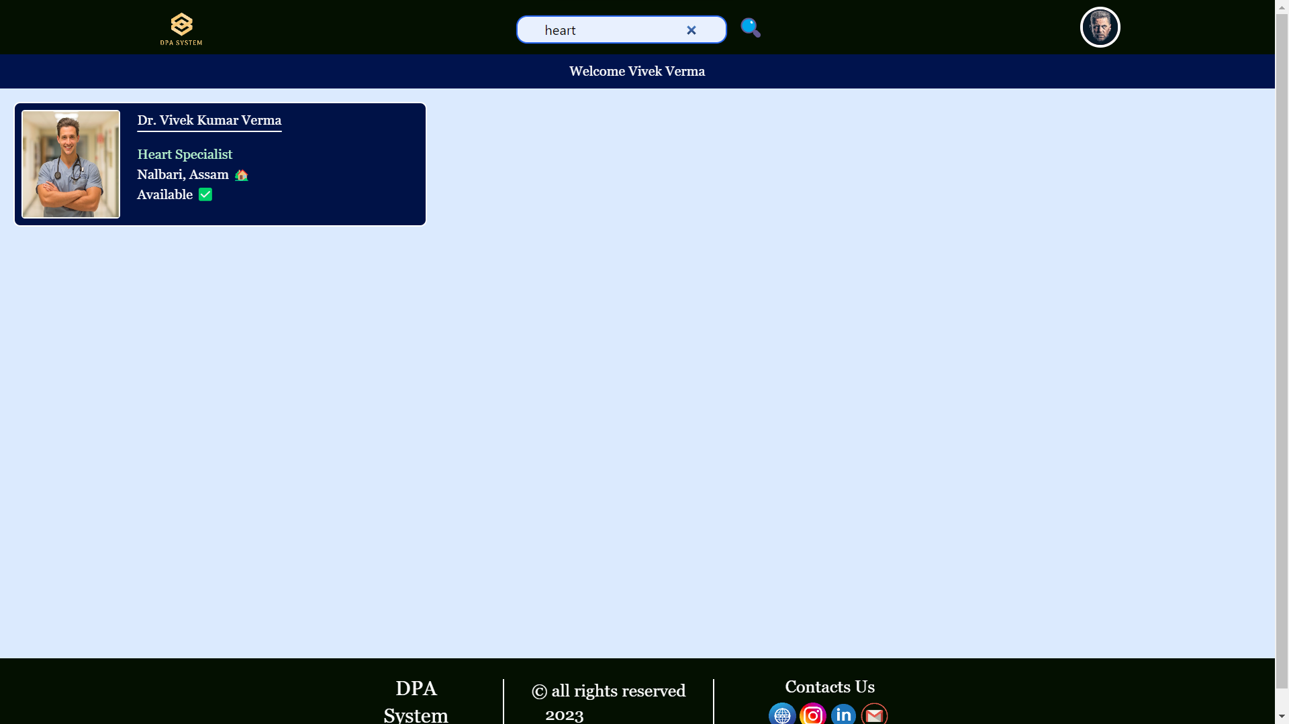
Screenshots

Slide 33
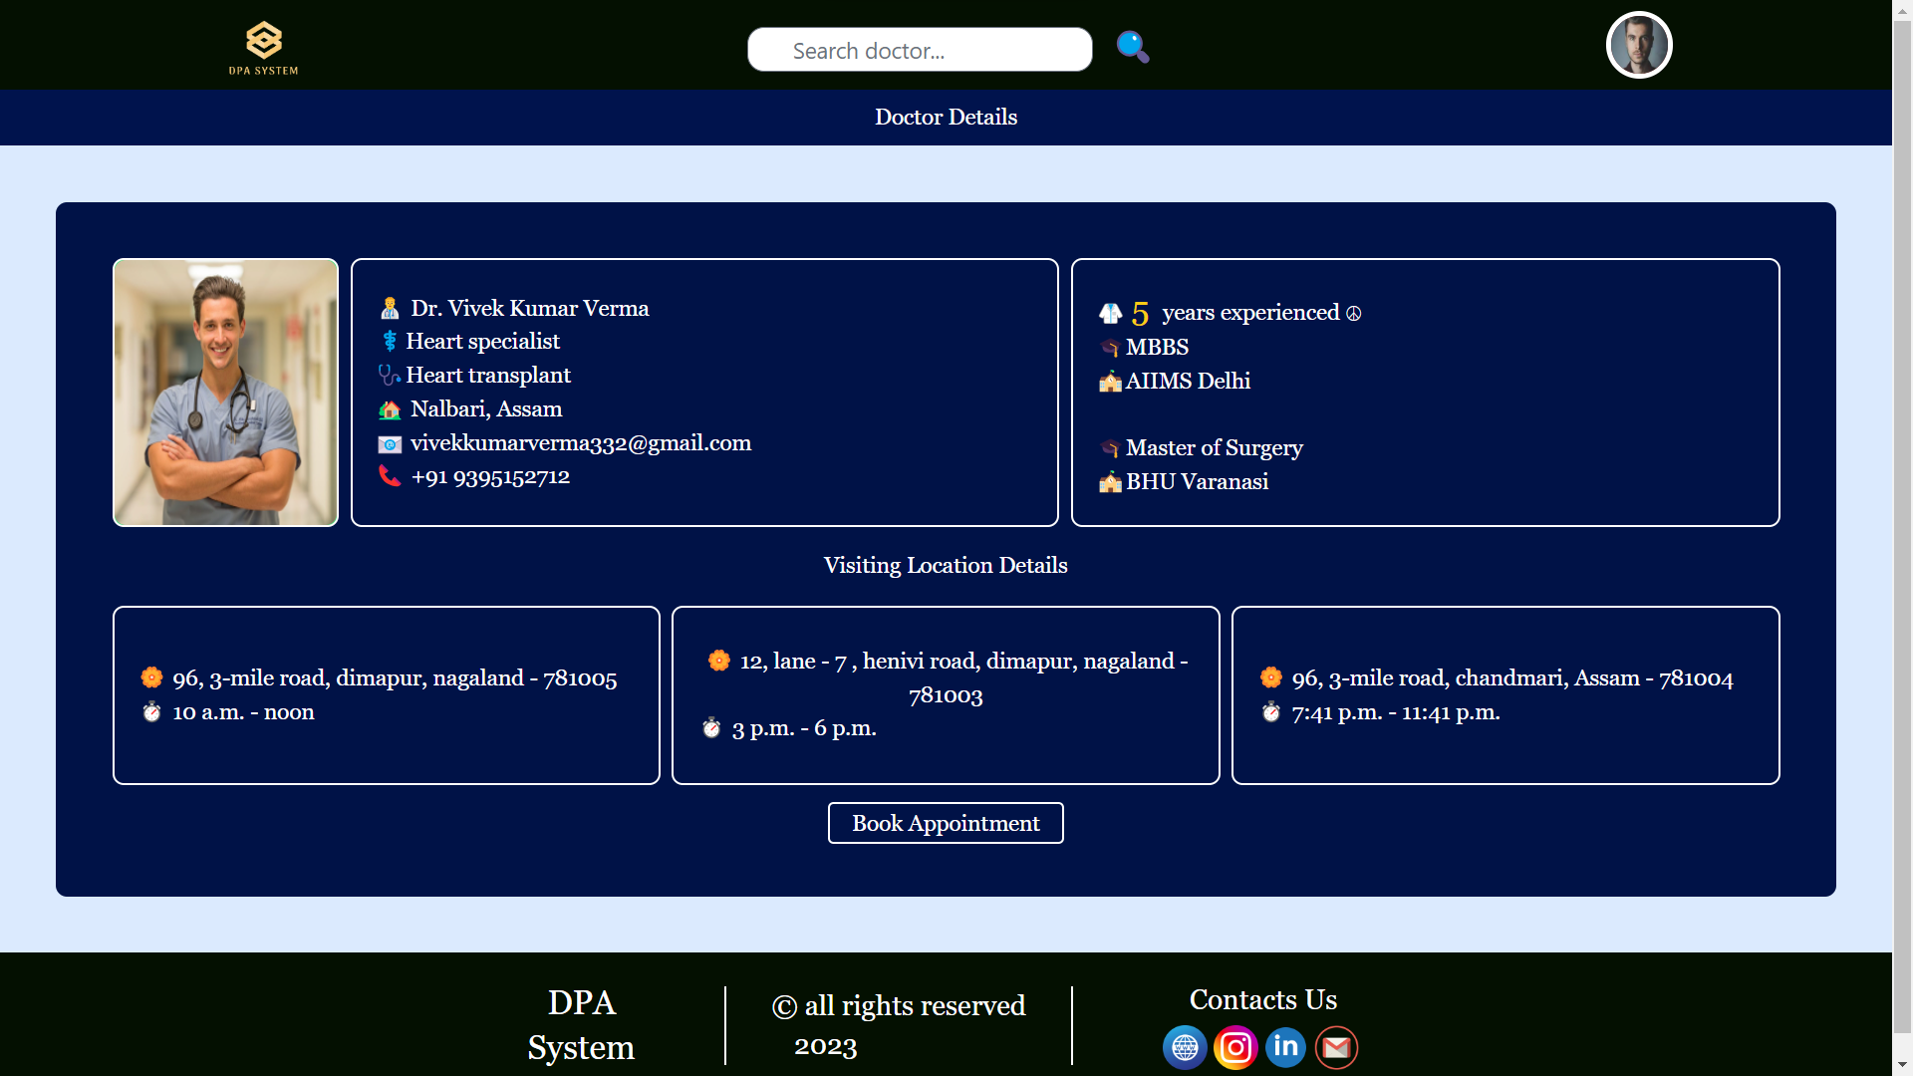
Screenshots

Slide 34
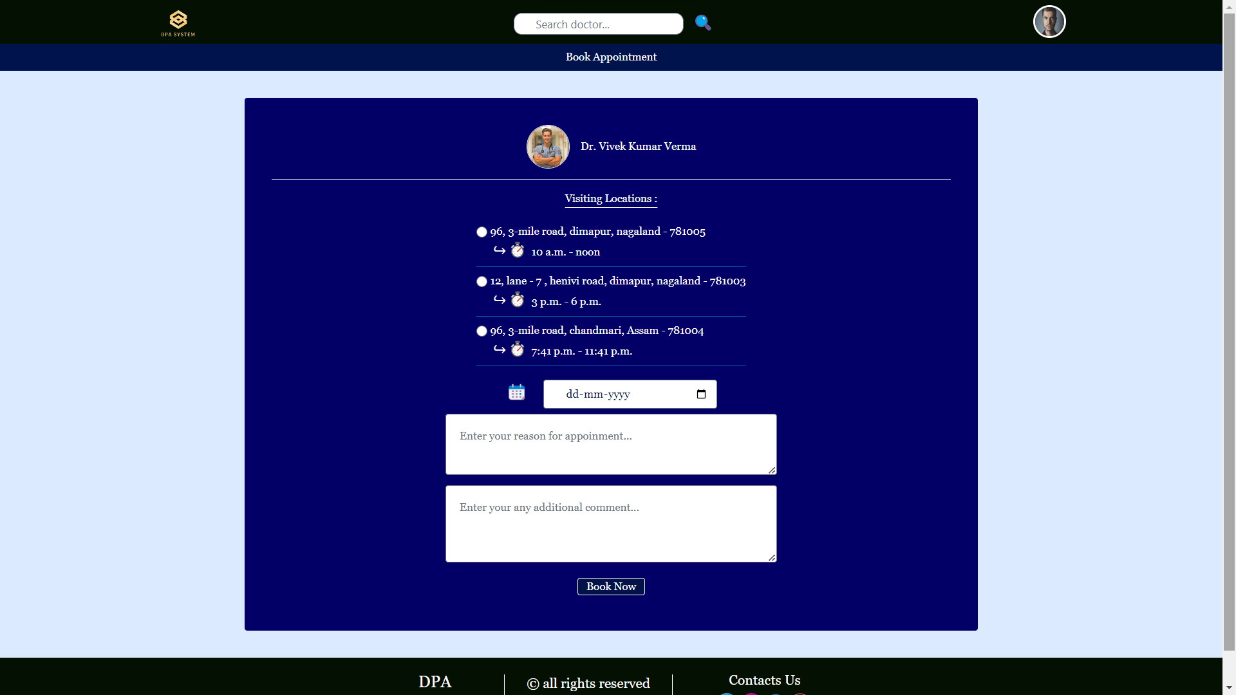
Screenshots

Slide 35
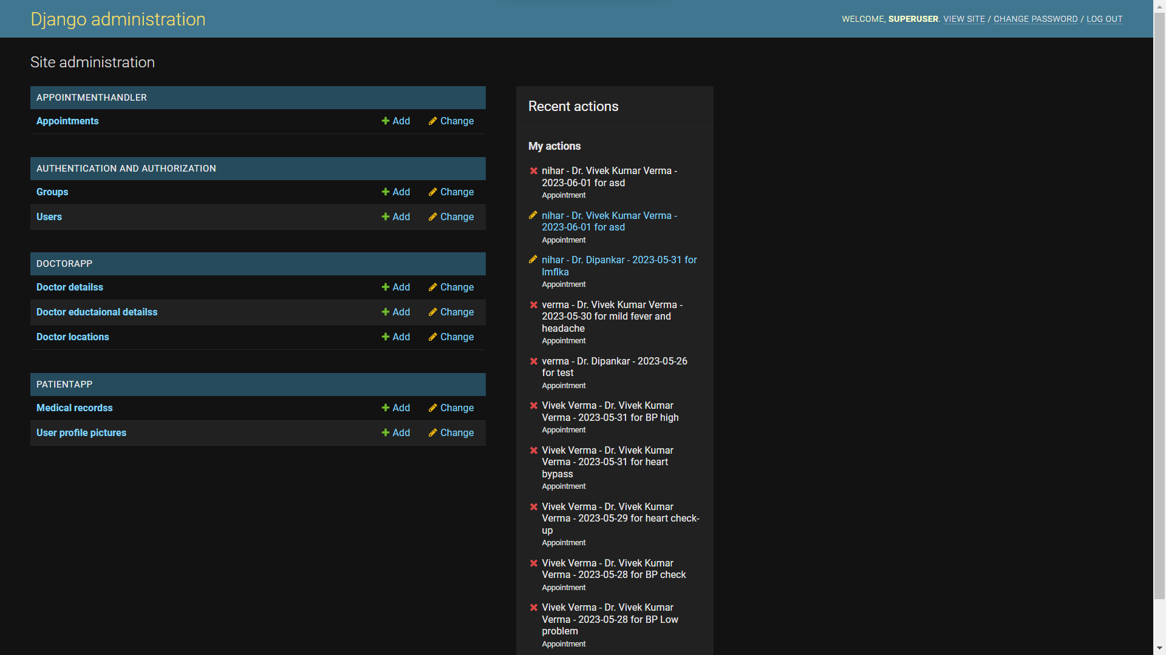
Screenshots

Slide 36
Future Scope
Our system is designed to evolve and adapt to future needs.
We plan to introduce additional features such as telemedicine integration, patient feedback systems, and real-time Chat-system.
Regular updates and enhancements will ensure our system remains at the forefront of healthcare technology.
We want to integrate the features of EHR in future updates.
Develop a mobile app for the system.

Slide 37
Conclusion
Our Doctor-Patient Appointment System aims to revolutionize healthcare by providing an efficient, user-friendly, and comprehensive platform.
By leveraging the power of Django, PostgreSQL, SMTP, Jinja, and Tailwind CSS, we deliver a robust and modern solution.
Together, we can transform the way patients access healthcare services and doctors manage their practices.

Slide 38
Thank you everyone
for giving me this opportunity to complete this presentation and my post-graduation, in this amazing Tezpur University, on a good note !

